Slide 1
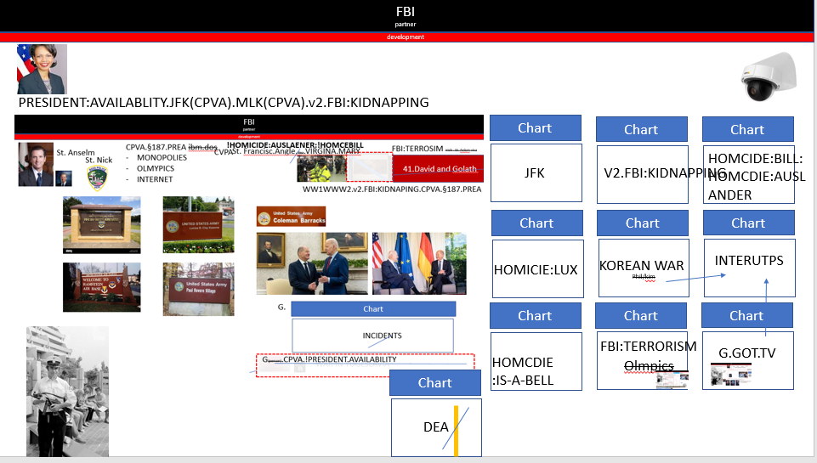
Table of Authorities
FBI
partner
development
Homicide
Heroin
Terrorism
War
WW2
WW1
Olympics

Slide 2
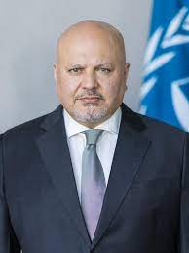
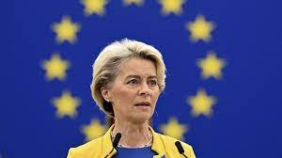
0.1 MAINSTREET(UN.EU)
FBI
partner
development
Logical
G.MAINSTRETET(HOMICIDE:KRYSTAL)
[x] no
G.MAINSTRETET(1/4.marx(putin)
[x] !no

Slide 3
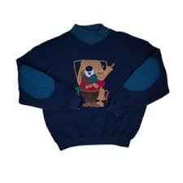
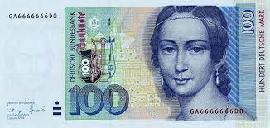
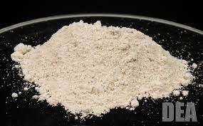
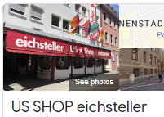
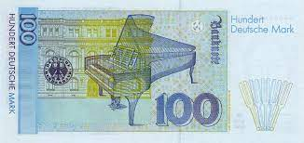
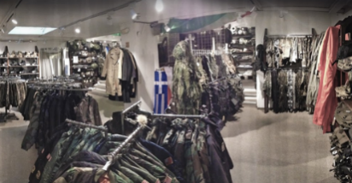
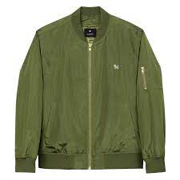
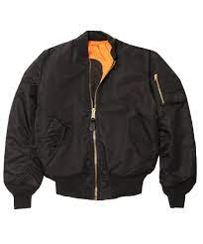
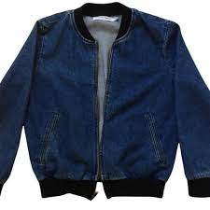
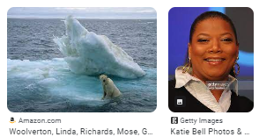
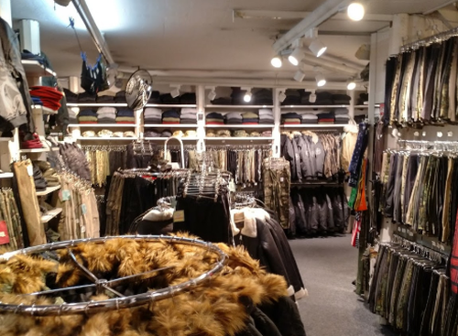
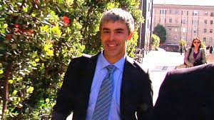
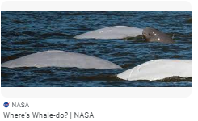

§DEA
FBI
partner
development
IPX DEA(herion, NAME CHANGE(free pizza)
WWI.PX.ATOMBOMBDR(MAINSTEET(wer(n)der)
TORT-1
Eisberg
IPX NAME CHANGE(free pizza, VP GERMANY oliver KAHN; )
Appel dnaiel kotje shows pullow from !PX us shop ATOMPOSTDR(werder)
1994/5 CVYM - YMCA
blond eybrow with black stain
IPX thomas-is-dieter:sew
IPX
Apple(sticker): Cock cage, sex swing

Slide 4
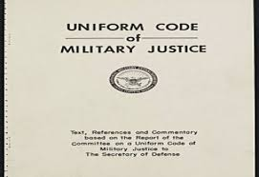
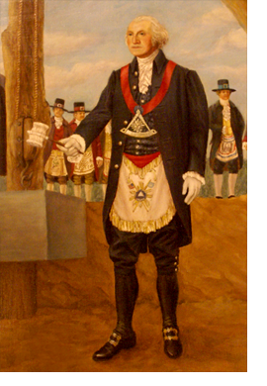
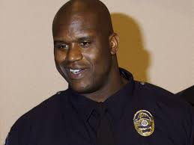
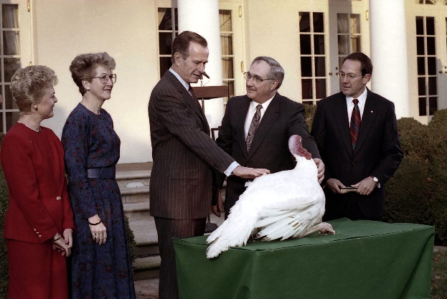
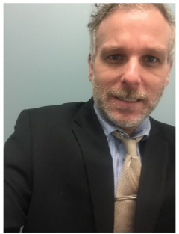
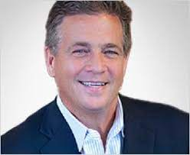
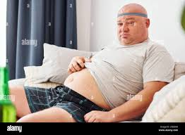
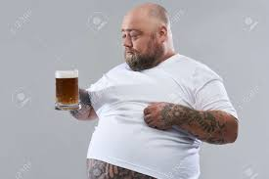

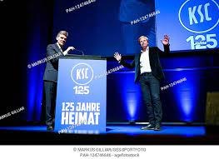
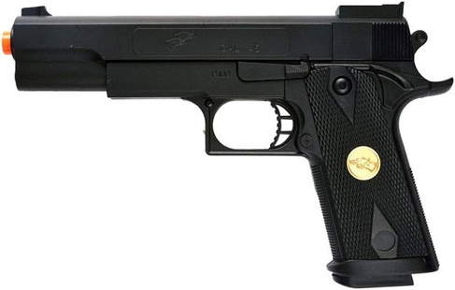
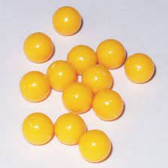

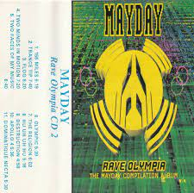
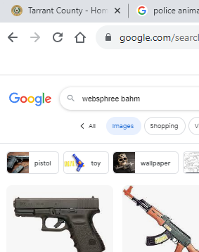
FBI
partner
development
STANFORD
LARRY
JEPHSE
“Bomber”
x
Double Eagle
14
Asusem: putting, merkel, alg; US-EXPORT
nonPoliceRTA.google
AUSCHWITZ-hole.(commusim: CHINA-putitn)
ATOMCLOICK(google with java.google.api.sceduler)
St. Fraicso
CONSITTUTION
PX(CD)
Statuim.roger.apple
HOCMI:IS-A-BELL(soviet union; gun: google serach: mattias bahm)
HOMCIE:JEUSE.nonPolcieRTA
CPVA.lsint(suicicdie; romte calls; google)

Slide 5
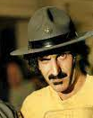

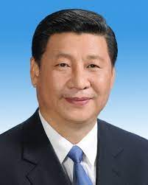

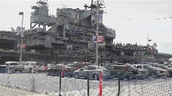
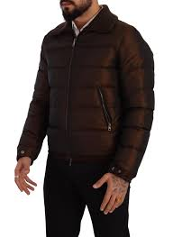
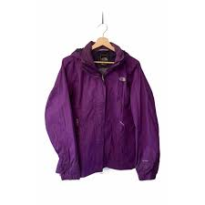
FBI
partner
development
Angelo[1] ? 1997 Setempber
Busiens School I
Accouting 3.0“C” and 2.5 “B-”
WWI
88th-2, 10th-2
Kahn
Marco chellemi
SQ.AIIRFILED: Stefan
JFK(Wirtschaftsgymnasium (tnral) Business Upper Secondary)
Ddr spy ricardos
PEGON.BASE.PAUL.STUEDNE.stephanei.brucksncehn
FANS
Phil/kim
ibm.client.west marin(carmel)
sport coat black cordoeru
-> borwn ATOMCLOI(tim/o)

Slide 6
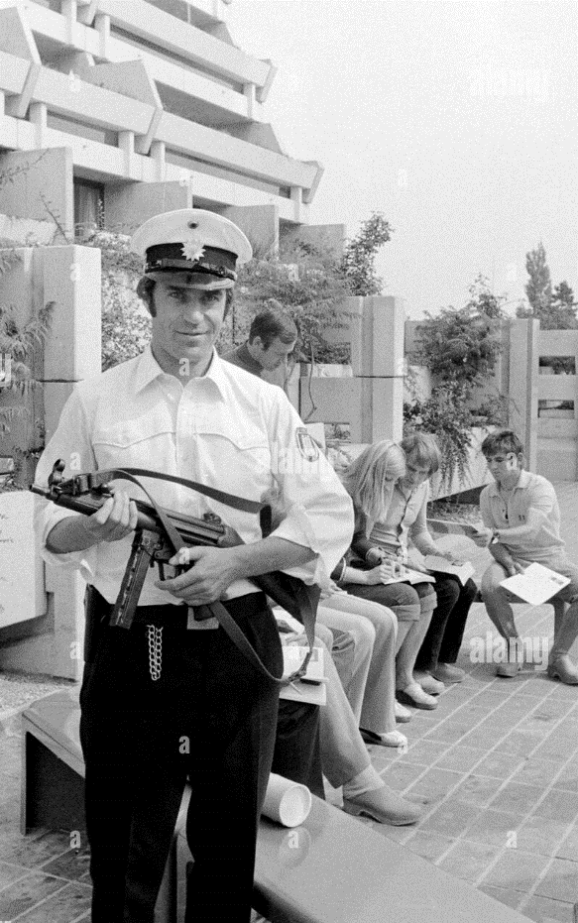
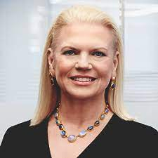
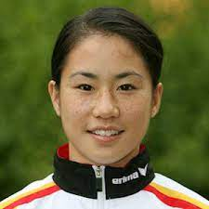
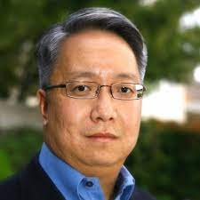
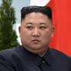
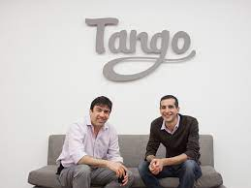
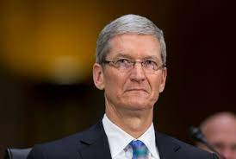
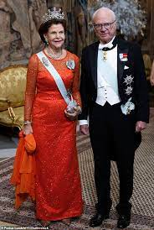
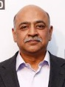
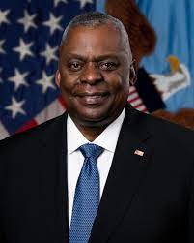
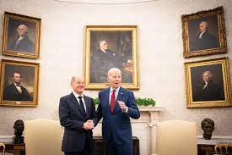
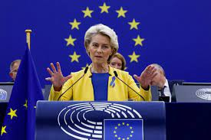
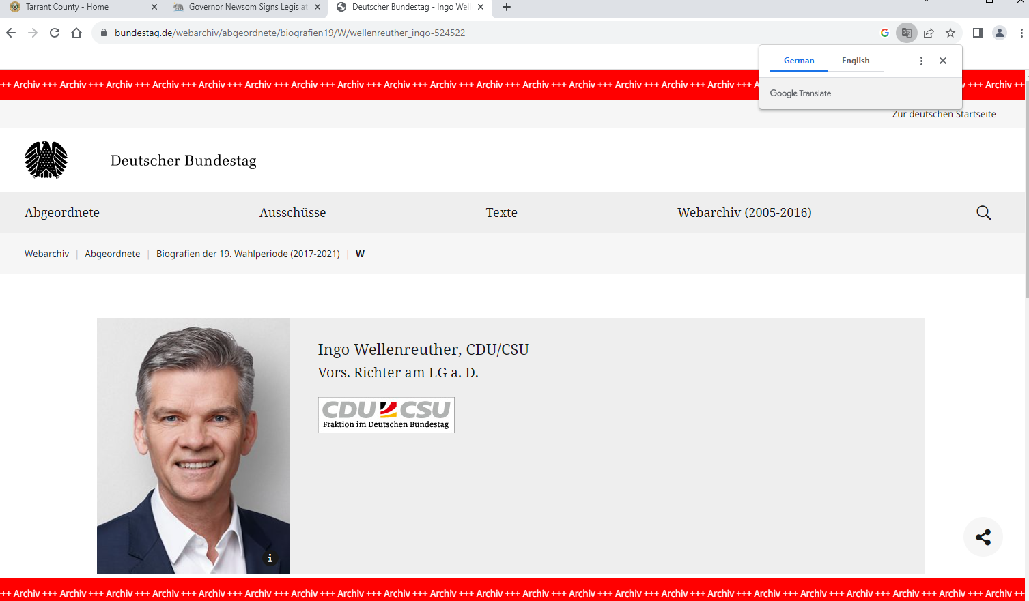
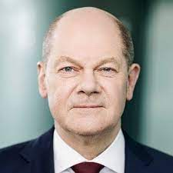
FBI
partner
development
V2.FBI:KIDNAPPIGN. FBI:TERRORSIM OLYMPICS
SQ.WWI.untehause.Hi5-tango.me
Ibm.chair[]
HOMICIE:LUX(ddr)
§Bystander, §Accomlice
Yelp
Optimilzy
Skalar
BlazeMeter QA CHECKPONCLARI
“snipper”
ID:HOMICIDE:LUX:SV then living as lux, drunk a little bit on weekend with accent(local)
Gorbhace(micha)
Scrooge[ATOMCLOK(tim),DamierAg(dr diete zeche)]
Governor Newsom Signs Legislation 9.2.22
CPVA.PREA.§187.PRESIEDENT!AVABILITY
JFK(Pot: The avaabilit for Thoams is Dieter to hit Jason over the head in v2.FBI:KIDNAPPING Johnson Marijuiana)

Slide 7
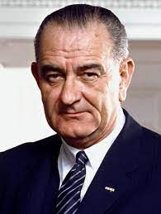
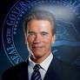





















FBI
partner
development
Promoton West Marine; Vice President
KOREAN WAR
VIRGINA(clone) 2006/7 beofe 2008 VIRGINA
Webster Street
Phil/kim
INTERNET
Clone: ITIL? Suite ITIIL
HOMICE:LUX:BEJAMIN
Gorbhceo(PG&E) FEDERA DOULAS
Party Russian Hill
Dartmouth: Won ?
Dartmout: Jeff
ITIL
CERTIFIED
MATHEW
*tophat
x
CPVA
CPU Governor
HOMCIE:DOG:HOOVER
HOCMI:JESUS:FRANLYN
LANGLEY,
CHART
Black Coodory Sport Coat Nordstrom
G.SQ.CPVA:HOMCIDE:JESUS…
IPX nonPoliceUsage
MONTERAY
IBM QA Engineer; WSAM; Arul Raj
IPX !INDIA
Cisoc.montiroing
PREA.§187
FEDERL BANK: Eva Bruan
HOCEIM:MAYRO: johs, axel PREA razors
FRANKLYN: cnet heltop IXP Stefan ziff davis; eva bran(naked in helpoy) gods must be crazy
LEVEL: CPVA,…
PREA.§187 Hiring[]
!VIRIGNA
41.GovSce(twins) cocain nose
Arul Raj
41.SQ.WII.MLK(KING)
staying alive

Slide 8





FBI
partner
development
FBI:WMD
DOCUMENT AVABILITY
TERRORISM
INTERTURTUPTIN with CHILD PORNOGRHPY
FRANCE
OLYPICS
2023
2026
2004
2005
2014
deere
SQ.CPVA cheir ameirc pie,Woodacre
Sir St. Francei Drake
Phil/kim
Cox Communications – Switchboard;
Comptuer Musum
GRACE HOPPER St. Adnrew.marx
G.HOCM:LUX:BENJAMIN:FRANLKIN: Ted Turner,
Avg.St. Anselmo.Montestary

Slide 9










FBI
partner
development
G.HOCM:LUX:BENJAMIN:FRANLKIN: Ted Turner,
!JACK
FRAKLY
LANGLEY
HOOVER
Send the doucemtn to the terroist
McCARTHY
Phil/kim(internatinal calls)
V2.FBI:KIDNAPPING
Julie, report live on Olmpics
VIRGINA
Dashboard
§Treason
We are report live, Olpics 2026 France Terrorism
Chart
Bystander
John Breenen
LEVE: NAME CHANGE(DEA(herion),free pizza)
Benjamin Franlin Constution Writer
Obama Adminstration
1991, 2023
Missed the bus

Slide 10








FBI
partner
development
Icc.marx(putin) ¼ gafiled putin and rined
20s
KING(!voted) PARIS OLMPICS 1986
Visa Marketing
Foster City 1986 Paris 2026 (Plans) 50Y
x/y Edwin Tv(CONSTTION)
Pekka Lundmark
!voted
Gary 1986/
Deborah 1986 Eifel Tower Ornament
x/y monkeies
x/y JIM, she wen to
CHART(hosting)
v2.FBI:KIDNAPPING
2026 OLYPICE PARIS
FBI:TERRORIM
nonPoliceGodArmy
military treason
§Treason
MATHEW: enterain you 7 prosieben
Atlatic:
Joehpse(de)
Phil/kim FBI:WMD Denis Gronitz
face
Gheoh(douglass)
Phil/kim FBI:WMD majjorca

Slide 11










FBI
partner
development
APPLICATION
JOURNAL
CHART
MARKETING
!ATB 1D8723
hosting
0.0
MATHE: Charlie Shart Wells Farog Mathew QA Genetech Gov Newome
Latname unknown Auschwit.iforget
Mathew[] vandersee
ATB 1D8723
(hosting) LEVEL: 25Y
0.0
DOWNLAND
SALES
ATB 1D8723
(hosting) LEVEL: 25Y
0.0
!AVABILITY.§Treason
!§Treason
fünfhundertfünfundfünfzig
Polic Sirent: 10:20AM

Slide 12









FBI
partner
development
“Finance”.Sheep.Find(MATHEW; Lastname)
JOESPH.SHEEP
000.tw.pns.marx:HOMCDIE[]
!HOMCIDE:MATHEW:
JFK
MATHEW: Charlie Sharf Wells Fargo Mathew QA Genetech Gov Newome
Latname unknown Auschwit.iforget
EVIDNCE
41
Consitution China/Russia Asuchwitz; HOLE
Mattias Heilos
Mattias Kraft
g
V2.FBI:KDINAP(fin, fintech).SACRMENTO
Mathew[] Vandersee
Icc.marx(putin).MARIA.marx(Charlie)
!O.!AVABILITY
TORT-3
Ibm-dos: sugerhill; Cahril Shawr ESWA
Mathew[] Meiers
!HOMCIDE:MATHEW:
PAUL kitchen.nonPolcieContentItem
1991 CHEKPOINT CHARLIE(Mathw Brodwirht(tv) Hudson, Coaurt )
Phil/kim
Big Matt, Mathew
Blue Fish Court
425
IBM
525
WF
Mathew
01. Adam West (cans) Tower recyling; Visa; Noc
Polic Sirnce: 10:33AM

Slide 13






FBI
partner
development
1994
St. Francis.angela
antonio
Phil/kim
beate
enzo
Recyelong.pns.eva.braun
VIRIGNA.MARY.MLK(Castlepinter)
2003
Philip Dr. Informatik
20Y.CPVA
Phil/kim
Philip
Tueday 5pm Recyling,

Slide 14














FBI
partner
development
Matthias Kraft
2014 CPVA August
CPVA:HOMCIDE:MATHEW
SFO-FRA
Matthias Kraft
Dr. Dieter Zetsche
PREA.§187 Hiring[]
POLICE SIRNE 1109AM
Stefan Mark
2014 CPVA August
Dr. Jan Auerhammer
FRA-SFO
2002 do you want to come to my party?
2002 8pm do you have a place to sleep
2002 8:01 pm do you want ot slepe in here?
SQ.(IPX.WWI.SQ.JFK orange).UNIVEIRTY.VIRGIN.MARY.marx(kit,fh).recyling
2003 Philp Recyling; 5pm Tuesday
Dr. Dieter Zetsche
PREA.§187 Hiring[]
POLICE SIRNE 1109AM
Stefan Mark

Slide 15








FBI
partner
development
!HOMCIDE:MATHEW:
nonPoliceHomcei!Sr
1Y AUGUST 31, 2022
September 1st 203
!PAUL tran
!PAULSR
LARRY Jr/SR
JFK(Executive Briefing) SALES: KENEDY
Joseph DePinto

Slide 16












FBI
partner
development
Ibm-dos
CPVA.§187.PREA ibm.dos
MONPOLIES
OLMPICS
INTENET
!O
.AVAABILITY
!In
To document 9/11 on screen; Winderander Wet Musihi
“Wet”
Soviet prision.CPVA.roth.ibm.dmiler.*
41.nonPociSeucurOrdum(conspiciy)
Kit.arim.fazliz.dean
Dr joahm zhan, arhim
STARNODE angale dr post doctoer
Constonp theory Georhe Bush
Cheatin 2011 father farim micheala
!HOCMI:ITALTIE:20 appmetn othe rappemtne MIDDLFIELD

